Slide 1


Optimizing Dell’s Shift to a Subscription-Based Model
PRESENTED BY EITAN TOUBIA, DHEERAJ SHETTY, MARIAM SOULEYMAN, AND PETER SARPONG

Slide 2

Agenda
1.
4.
Business Case Overview
Functional and Data Requirements
3.
5.
Current Process
vs
Target Process
Key Benefits and Outcomes
2.
Scope of Work
6.
Conclusion and Q&A

Slide 3





Overview
Challenges:
Transitioning to a subscription-based model to compete with AWS, Azure, and Google Cloud.
Manual quoting, invoicing, and vendor management lead to inefficiencies, delays, and errors.
Payment mismatches and invoicing delays strain vendor relationships.
Business Case
Impact:
Errors in multimillion-dollar deals jeopardize revenue.
Operational inefficiencies reduce responsiveness and competitiveness.
Benefits:
Enhance efficiency through automation and improved traceability.
Strengthen vendor and client relationships for sustained success.

Slide 4



Key Focus Area
Scope of Work
Quoting
Objective:
Optimize and automate key business processes to enhance operational efficiency and ensure traceability in payments and quotes.
Automate generation for faster, error-free results.
Core Goal:
Establish trackability between Payments and Quotes to ensure smooth client relationship management and end-to-end process integrity.
Sizing
Streamline for improved accuracy and efficiency.
Partner Invoicing and Payment
Ensure seamless and reliable transactions.

Slide 5

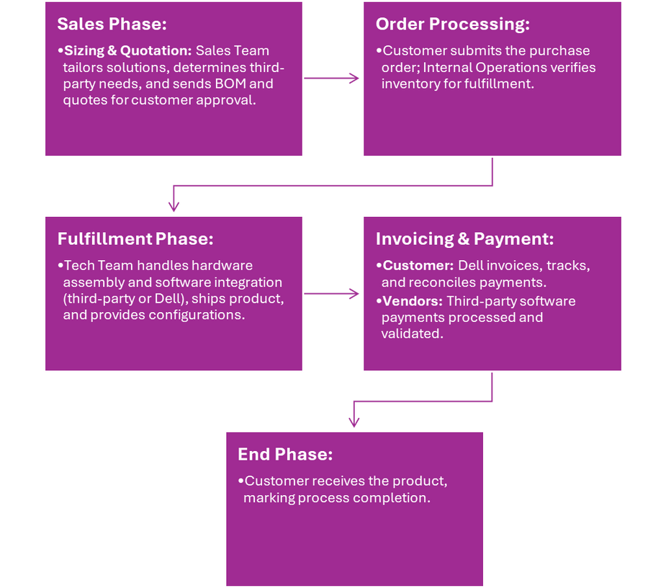

Dell’s Current Process
Key Phases:
Sales: Manual sizing of client needs and configuration of solutions.
Quoting: Delays due to manual data handling and dependency on third-party vendors.
Fulfillment: Bottlenecks in third-party coordination.
Payment: Errors in invoicing and reconciliation increase complexity.
Issues Identified:
Lack of automation leads to inefficiencies at all stages.
Delayed responses impact client and vendor trust.

Slide 6
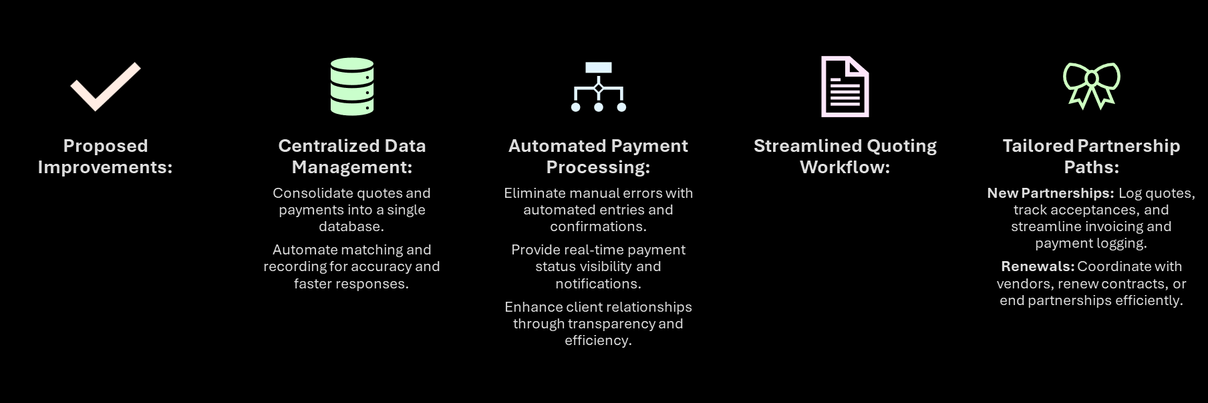

Dell Process Redefined

Slide 7
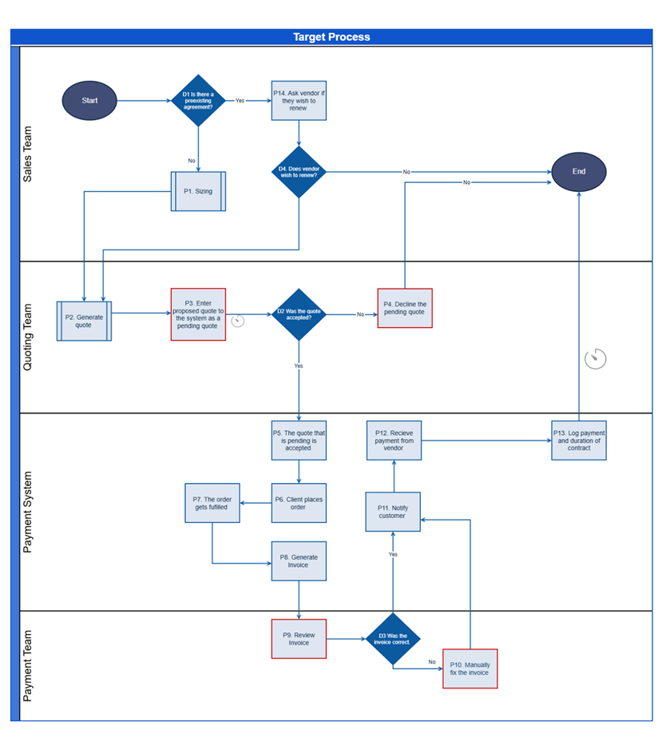
Our Process Visualized

Slide 8
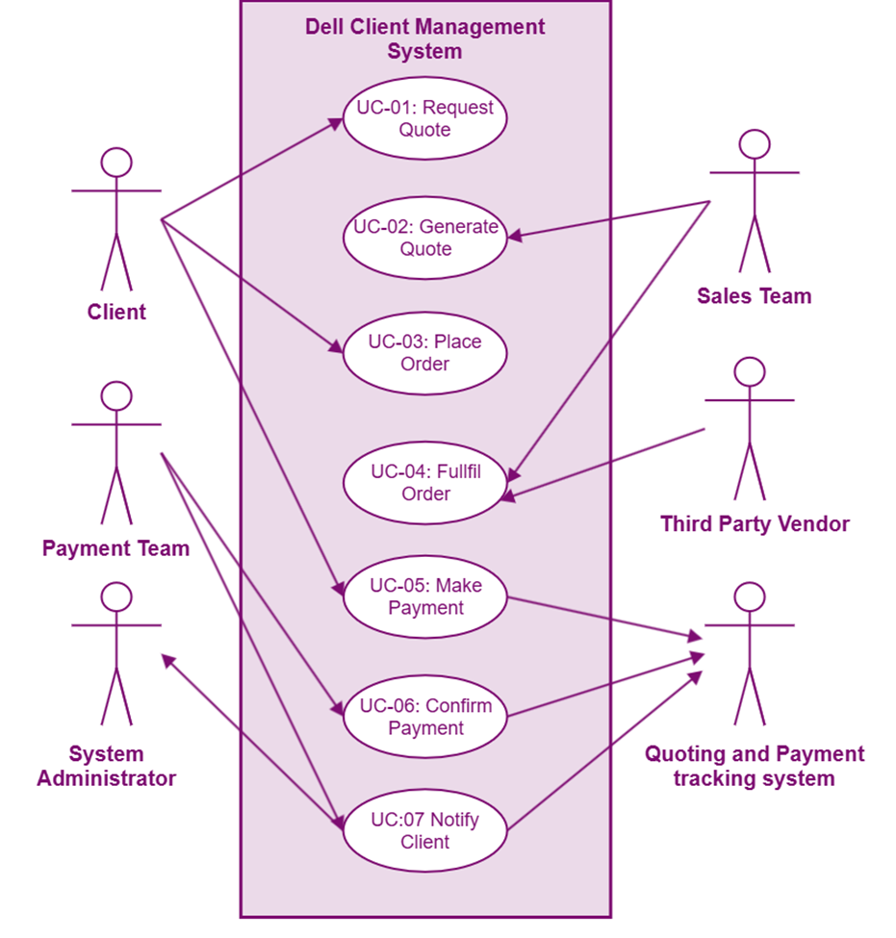

Functional Requirements

Slide 9

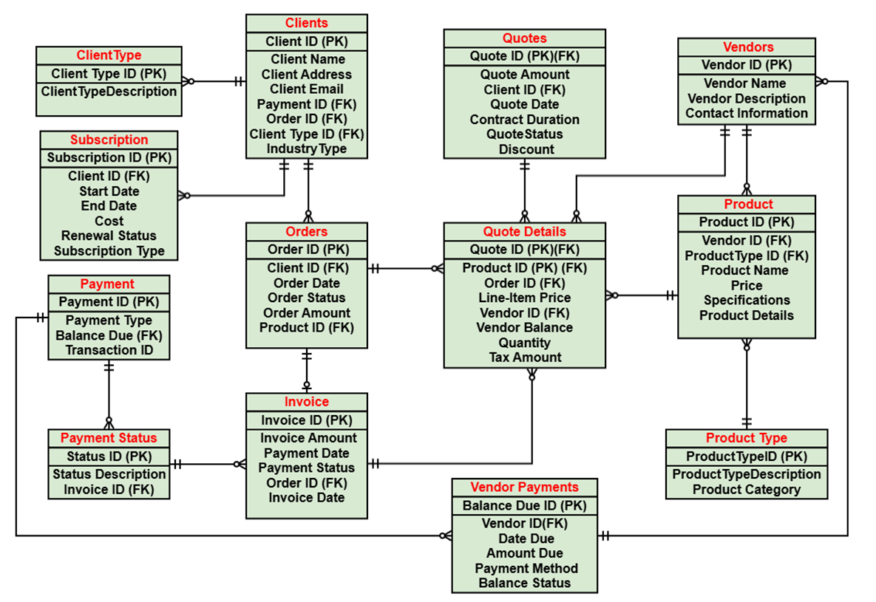
Data Model

Slide 10

Conclusion
By implementing the proposed processes and data model, Dell can effectively manage payments and quotes, addressing inefficiencies and enhancing operational excellence. These improvements position Dell to succeed in the competitive subscription-based market.

Slide 11

Q and A
ASK AWAY!

Slide 12


Thank you!

